Slide 1
EPS
Electrical Power Subsystem

Slide 2
1
Introduction
What is EPS and What it does.
2
Functional Description
Brief of EPS SW & HW main features
3
Software Static Design
EPS Main Tasks and Parameters
4
Software Dynamic Design
CONTENTS
Scheduler Sequence & Timeline
5
Hardware Design
Components & PCBs

Slide 3
1
Introduction
What is EPS
EPS Responsibilities

Slide 4
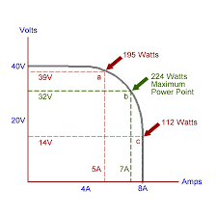
What is EPS
The Electrical Power Subsystem (EPS) is responsible for:
Charging the batteries from the solar panels using the MPPT technique.
Subsystems power management(Voltage & Current Monitoring).
Batteries temperature control.
Maximum Power Point Tracking (MPPT):
It is an algorithm that included in charge controllers used for extracting maximum available power from PV module under certain conditions.
The voltage at which PV module can produce maximum power is called maximum power point (or peak power voltage).
Maximum power varies with:
solar radiation
ambient temperature
solar cell temperature.

Slide 5
2
Functional Description
Hardware Main Components
Software Main Functions

Slide 6
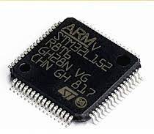
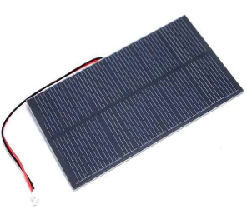
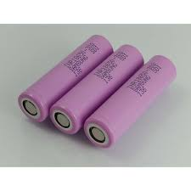
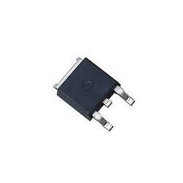
Functional Description
Hardware Main Components:
• Microcontroller: STM32L152(Ultra Low Power Consumption)
• 18650 Li-ion batteries.
• MOSFET switches for controlling the subsystems power
• 4x 1.5W (6Vx250mA)

Slide 7
Functional Description
Software Main Functions:
1. Communication with OBC.
2. Power management and distribution including:
MPPT battery charging system, load control (ON/OFF).
3. Measuring and Sensing:
for voltages, currents, and temperatures for the subsystems, batteries, and solar panels.
4. Performing Safety Checks:
Checking if the voltages, currents, and temperatures are within the safety limits.
5. Status and Error Reporting:
Sends error status via the UART debug port.

Slide 8
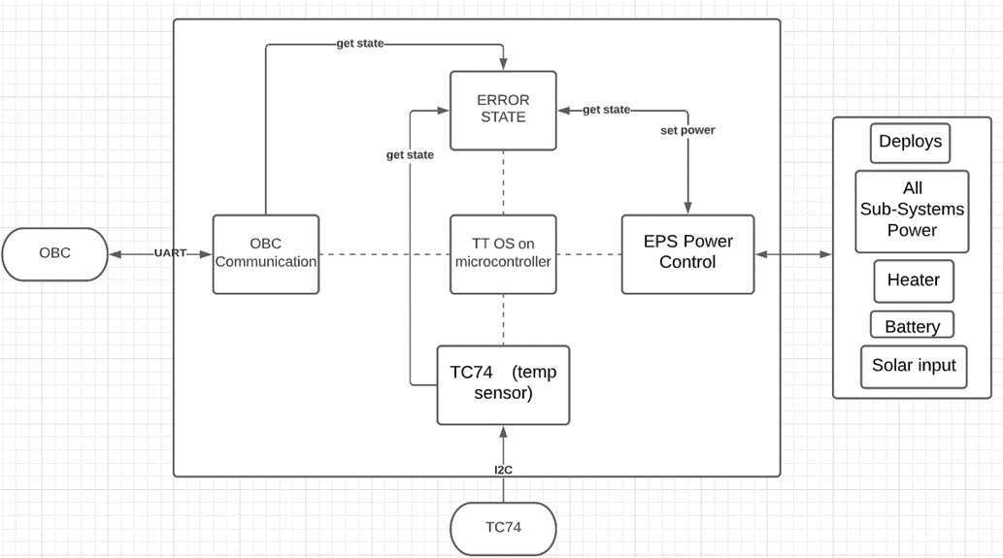
Functional Description
Software Main Functions:

Slide 9
3
Static Software Design

Slide 10
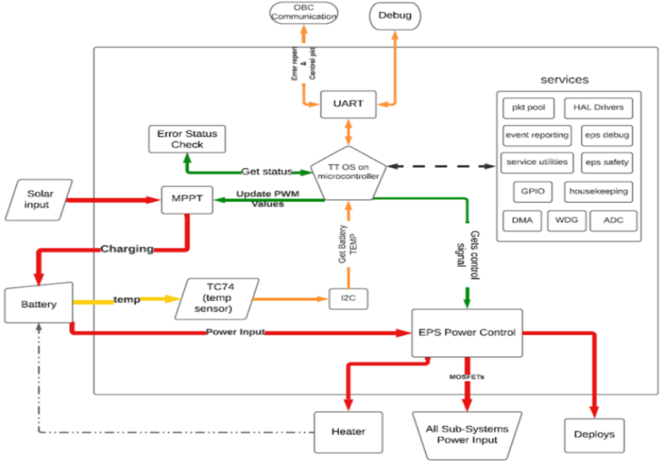
Static Software Design Block Diagram

Slide 11
4
Dynamic Software Design
Tasks Scheduling
Timeline of Execution

Slide 12
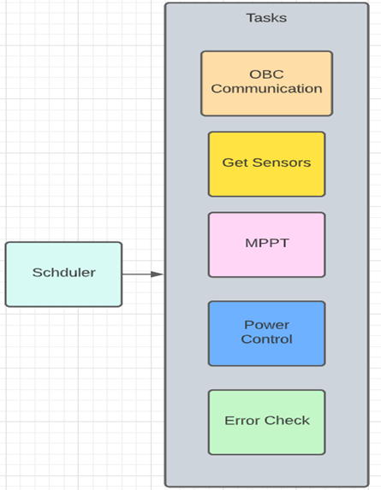
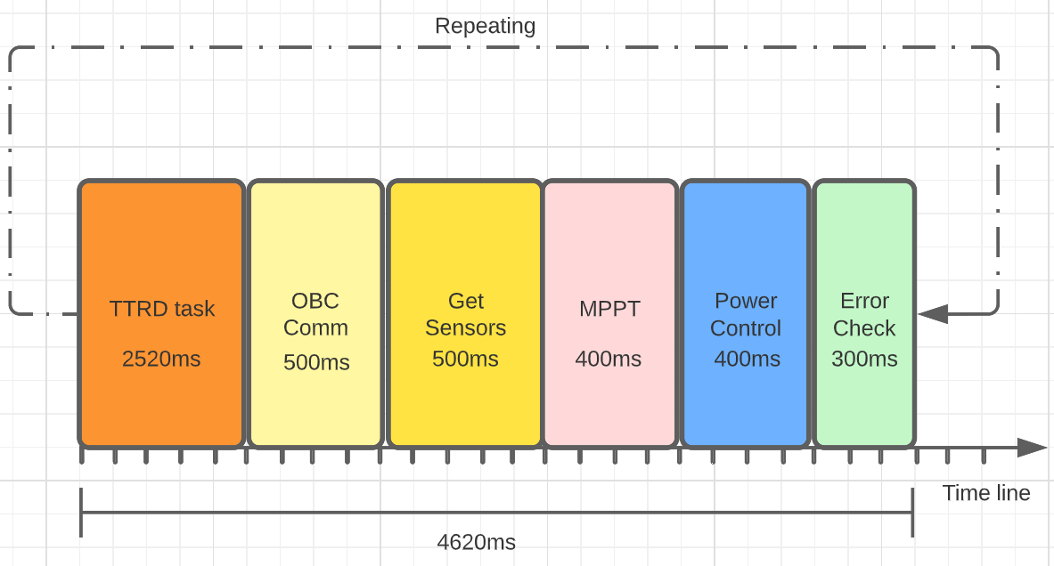
Dynamic Software Design
Tasks Scheduling:
Timeline of Execution:

Slide 13
5
Hardware Design
1.Solar Panels
2. Batteries
3.Power Distribution and Management
4.Microcontroller
5. PCB Design

Slide 14
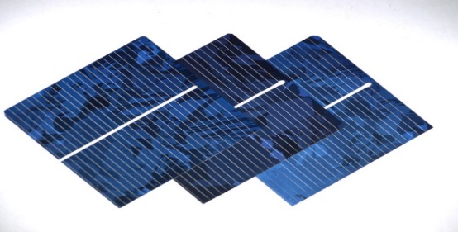
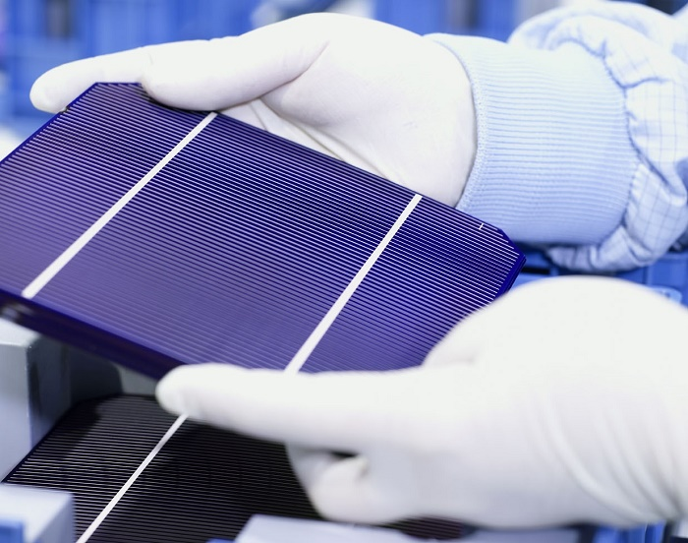
1.Solar Panels

Slide 15
2. Batteries
 | Lithium polymer | Lithium ion
Chemical reaction | Varies, depending on electrolyte. | Varies, depending on electrolyte.
Operating temperature | Improved performance at low and high temperatures. | 4º F to 140º F ( -20º C to 60º C)
Recommended for | Cellular telephones, mobile computing devices. | Cellular telephones, mobile computing devices.
Initial voltage | 3.6 & 7.2 | 3.6 & 7.2
Discharge rate | Flat | Flat
Charging temperature | 32º F to 140º F (0º C to 60º C) | 32º F to 140º F (0º C to 60º C)
Storage lite | Loses less than 0.1% per month. | Loses less than 0.1% per month.
Storage temperature | -4º F to 140º F ( -20º C to 60º C) | -4º F to 140º F ( -20º C to 60º C)
Notes | - Typically designed to be recharged in the device rather than in an external charger. - Lighter than nickel-based secondary batteries with (Ni-Cd and NiMH). - Can be made in a variety of shapes. | - Typically designed to be recharged in the device rather than in an external charger. - The chemical construction of this battery limits it to a rectangular shape.

Slide 16
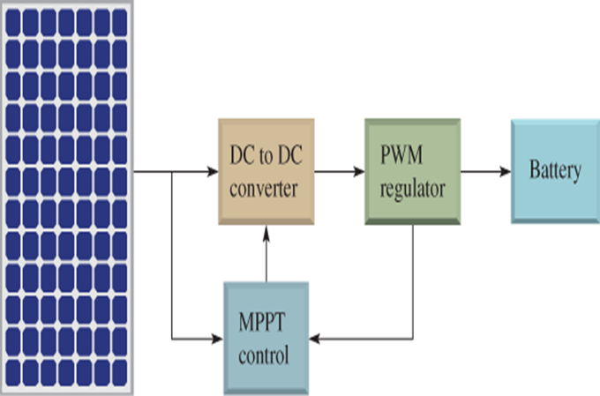
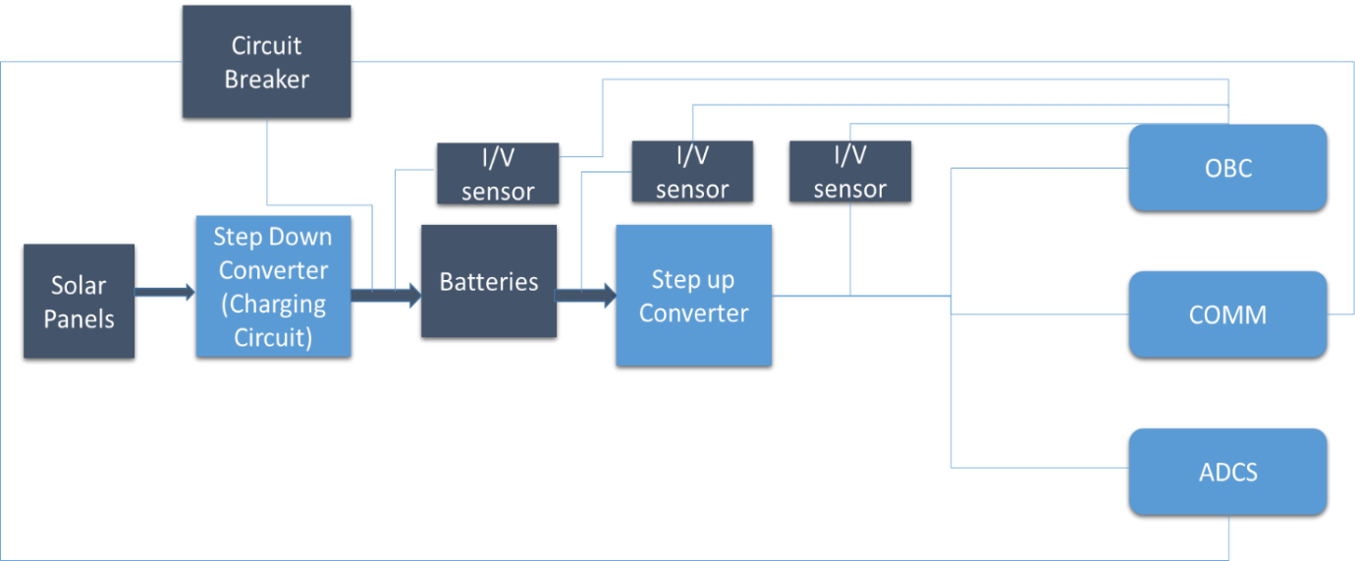
3.Power Distribution and Management Block Diagram

Slide 17
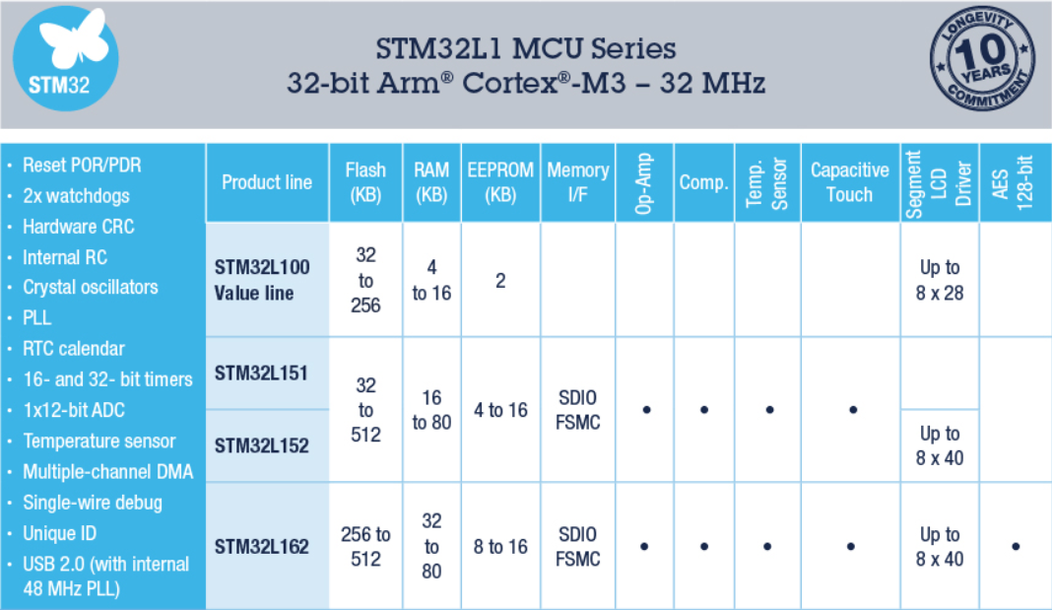
4.Microcontroller
ST Ultra-Low Power (L Family)

Slide 18
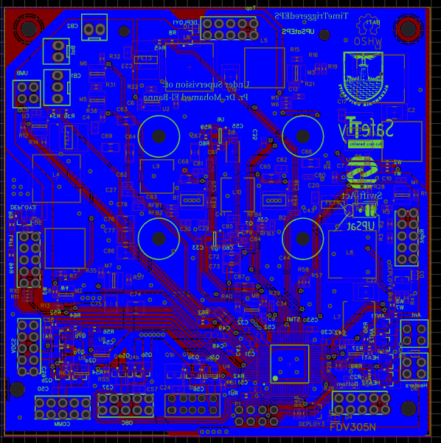
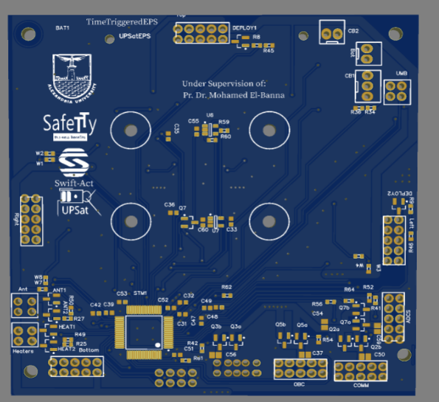
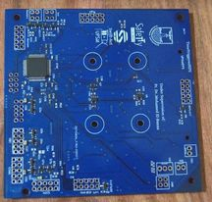
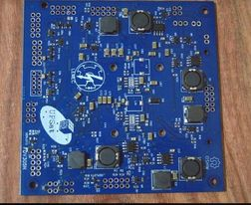
5. PCB Design

Slide 19
Hardware Implementation

Slide 20
1
Hardware Design Process
Workflow of Design
2
Suppliers & Shipping
Components selection challenges
3
Fabrication & Assembly
Fabrication Facilities
CONTENTS
4
Testing & Troubleshooting

Slide 21
1
Hardware Design Process
Hardware Design Workflow

Slide 22
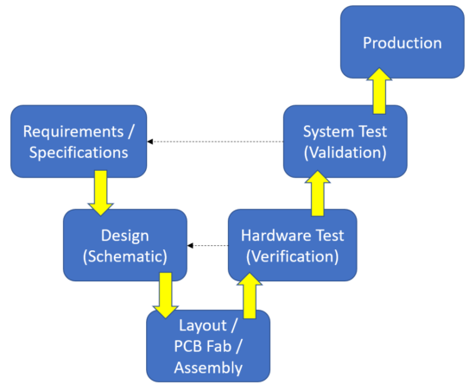
Hardware Design Process
Hardware Design Workflow:

Slide 23
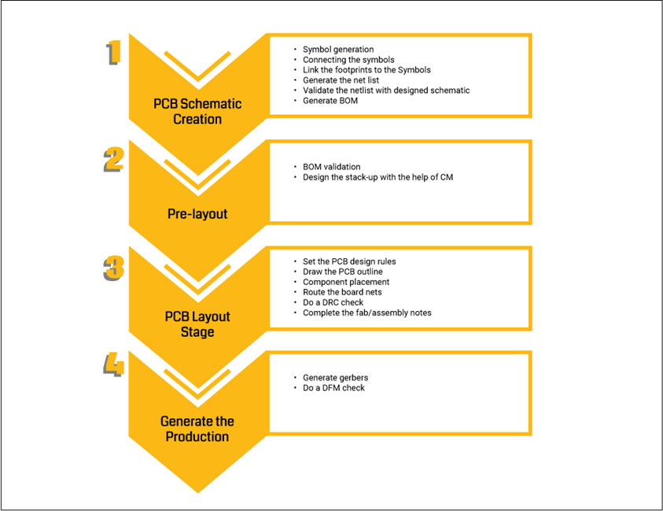
Hardware Design Process
PCB Design Process:

Slide 24



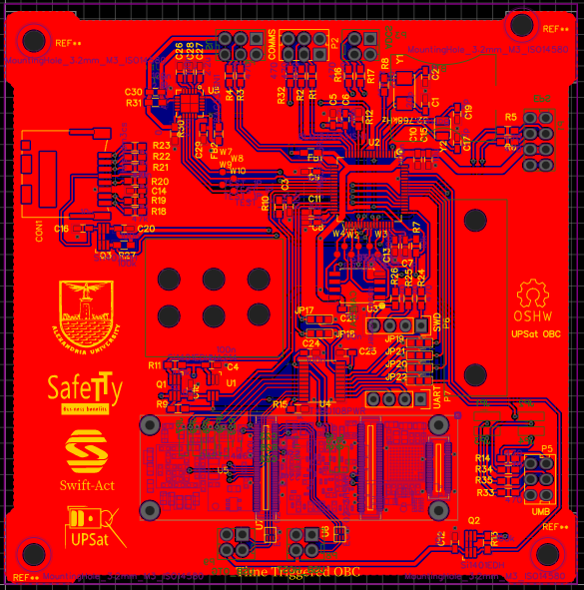
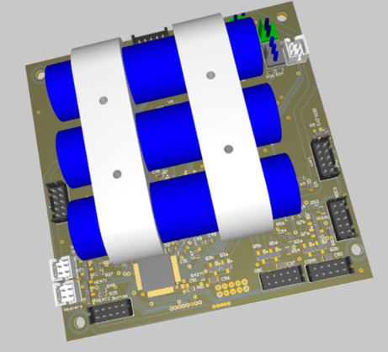
Hardware Design Tools
Hardware Design and Simulation Software:

Slide 25




2
Suppliers & Shipping

Slide 26



3
Fabrication & Assembly
Fabrication Facilities

Slide 27
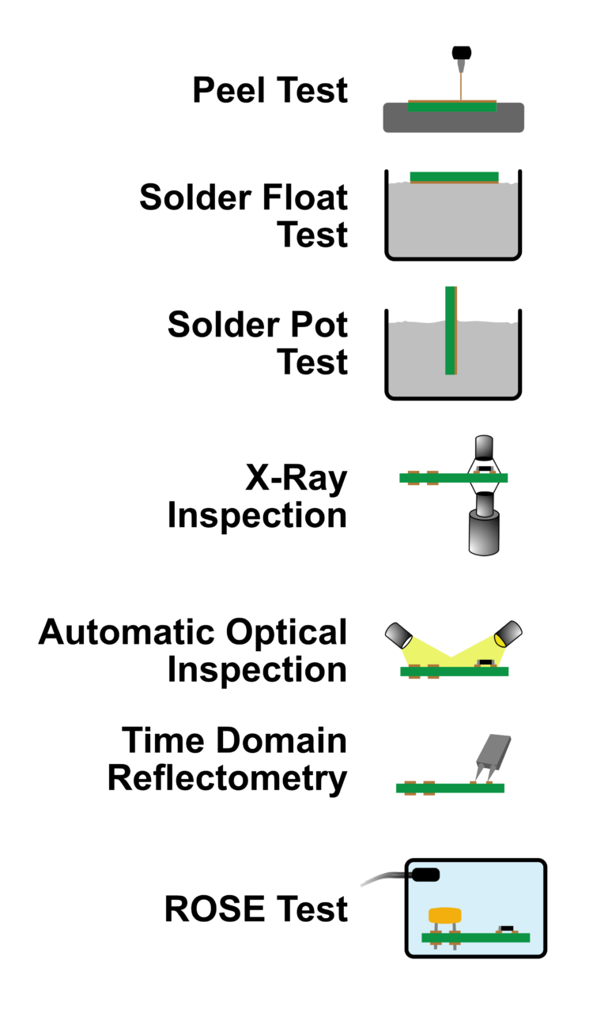
Fabrication Testing Techniques
Peel Test :used to determine the amount of strength required to peel laminate from board.
Solder Pot Test: determines the solderability of plated through
hole (PTHs).
Solder Float Test: measures the degree of thermal stress that a
PCB hole can withstand.
X-ray Inspection :used to view the PCB’s internal construction; including layers and vias. Can also be used to view inside of component packages to verify device types and authenticity.
Automated Optical Inspection AOI: performed to check solder quality and verify pad and trace connections.
Time Domain Reflectometry (TDR): typically done to
measure characteristic impedances. Can determine if differential traces are matched for good signal integrity.
Resistivity of Solvent Extract (ROSE) Testing: highly reliable test used to ensure that your board does not contain significant
surface debris remaining from manufacturing processes or
excess conductive material.

Slide 28
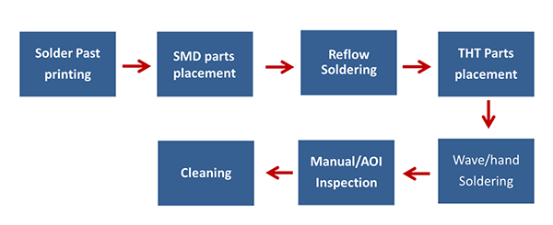
Assembly Process

Slide 29
4
Manual Testing & Troubleshooting

Slide 30
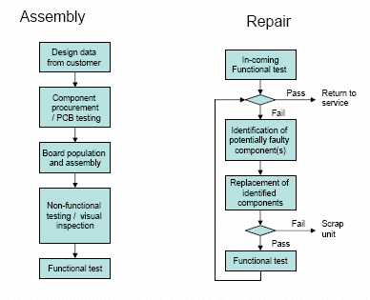
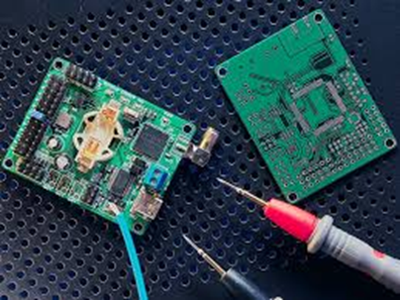
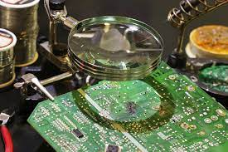
Manual Testing & Troubleshooting
Visual inspection
Flying Probe test (Manually)
Functional Testing (Specification & Requirements)

